Slide 1
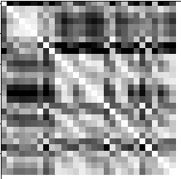
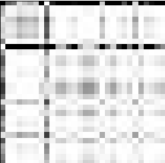
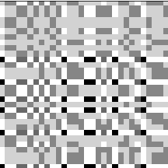
Recurrence Plot
Gramian Angular Field
Markov Transition Field

Slide 2
Input Layer with 3 channels:
RP, GAF, MTF
Convolutional Layers:
32 x 3 made with
3 x 3 x 3 Filters
+Leaky ReLu
Convolutional Layers:
64 x 3 made with
3 x 3 x 3 Filters
+Leaky ReLu
Pooling Layers:
64 x 3 made with (3 X)
2 x 2 Average Pooling +Leaky ReLu
Fully Connected Layer
+Leaky ReLu
Output Layer
+Softmax
3 x 30 x 30
3 x 30 x 30 x 32
3 x 30 x 30 x 64
3 x 15 x 15 x 64
128 or 256*
3
Batch Normalization
Dropout
Batch Normalization
Dropout
Batch Normalization
Dropout

